Slide 1
GETTING SET UP
Getting Online
Wifi username: inc_calgary
Wifi password: c@mmun1ty
Register an account on Wikipedia (if you haven’t already): https://en.wikipedia.org/wiki/Wikipedia:Tutorial/Registration

Slide 2

WIKIPEDIA EDIT-A-THON
Notes:
Sample Schedule:
4:00pm - Arrival + set up
5:15pm - Lead Instructor arrives
Test projector + screen
Set up wifi
6:00pm - Learners + guests arrive
6:00pm - Food, drink & networking
6:30 pm - Welcome + Opening Remarks
6:40pm - Formal workshop presentation
Workshop content here
7:30 pm - Open work time + networking
9:00pm - Teardown

Slide 3


READ, WRITE AND BUILD A BETTER WEB
Thanks to our partners
Notes:
c0d1ngf0rl1f3

Slide 4
AGENDA
Welcome + Introductions
Intro to Editing on Wikipedia
Group Example Edit
Open Edit Time
Work individually or in small groups on your own edits

Slide 5
WELCOME + INTRODUCTIONS
Your Name
Your ‘day-job’
What drew you to this event

Slide 6
Why are we here?
Less than 10% of editors on Wikipedia are women
When we don’t tell our stories or participate in the ways our history is preserved, it gets erased
Amplify the voices of women online
Promote Wikipedia as a site for preservation of information

Slide 7
LET’S GET STARTED!

Slide 8
WIKIPEDIA IS...
An encyclopedia
A tertiary source that provides a overview of information already the subject of publication
The goal of a Wikipedia article is to create a comprehensive and neutrally written summary of existing mainstream knowledge about a topic
Requires that information be verifiable in reliable sources

Slide 9
CORE CONTENT POLICIES
Neutral point of view
Verifiability
No original research
Notability
Reliable sources
More about core policies here

Slide 10
EDITING BASICS
* Adapted from Wikipedia’s Tutorial https://en.wikipedia.org/wiki/Wikipedia:Tutorial/Editing

Slide 11
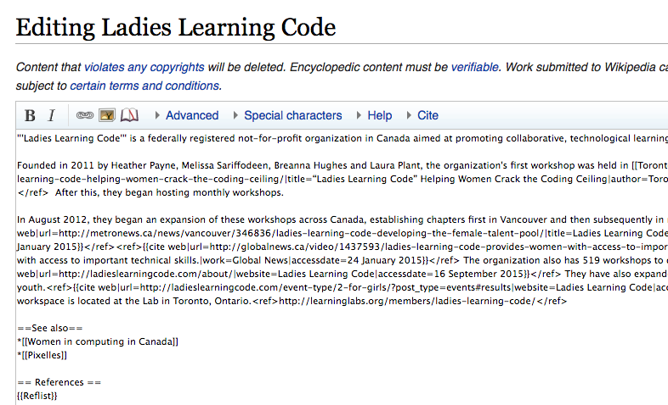
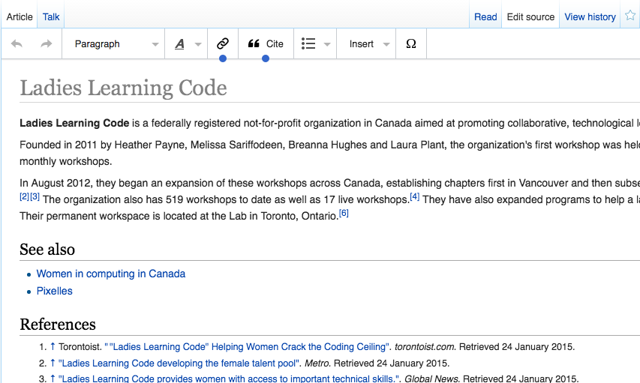
TWO WAYS TO EDIT
Classic editing through wiki markup
VisualEditor (must be logged in to use)

Slide 12
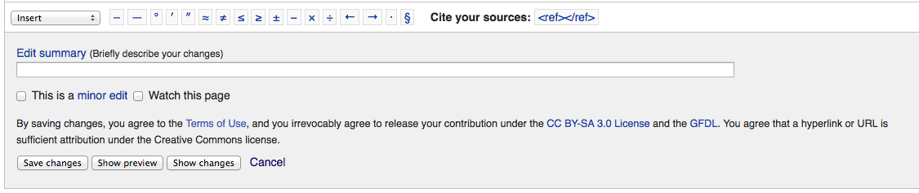
EDIT SUMMARY
Good etiquette (or "Wikiquette") is to enter an explanation of your changes in the Edit summary box
Short explanation is okay
For example: “fixing a typo”

Slide 13
SHOW PREVIEW
After you make a change use the ‘Show Preview” button
Lets you see what the page will look like after your edit before you save

Slide 14
SAVE YOUR WORK
Always, always, always remember to click ‘save changes’

Slide 15
CREATING NEW ARTICLES
An article must have already been the subject of publication in reliable sources, such as books published by major publishing houses before it can be its own article
Information on Wikipedia must be verifiable; if no reliable third-party sources can be found on a topic, then it should not have a separate article
An Article Wizard is available to help you create articles

Slide 16
PROTECTED PAGES
Some pages are protected from editing
View source tab instead of an Edit tab
You can edit these pages indirectly, by submitting an "edit request"
You can submit a request by clicking on the View source tab on that page and using the "Submit an edit request" link at the bottom right

Slide 17
GETTING REVERTED
If you ever make a change that gets reverted by another editor, discuss the change on the talk page
The BOLD, revert, discuss cycle is a popular method of reaching consensus, and may be useful for identifying objections, keeping discussion moving forward and helping to break deadlocks

Slide 18
GROUP EXERCISE (5 minutes)
Wikipedia’s Sandbox

Slide 19
WIKIPEDIA SANDBOX
Page allows you to practice edit
Go to:
https://en.wikipedia.org/wiki/Wikipedia:Tutorial/Editing/sandbox

Slide 20
FORMATTING
Intro to Markup Language

Slide 21
WHAT IS MARKUP?
Simple language for formatting
“Marking up the text” comes from print editing when the editors would annotate things like ‘bold’ this or ‘italic’ that
Simplified alternative to HTML
Easily converted to HTML for web browsers

Slide 22
BOLD AND ITALICS
surrounding a word or phrase with multiple apostrophes ('):
You type You get
''italic'' italic
'''bold''' bold '''''bold italic''''' bold italic

Slide 23
HEADINGS AND SUBHEADINGS
Headings are a great way to organize an article
Create headings surrounding the heading text with several '=' wiki tags. The more '=' symbols in the wiki tag, the more nested the heading is:
You type You get
== Elizabeth II hats == Elizabeth II hats === Straw hats === Straw hats

Slide 24
SUBSCRIPT AND SUPERSCRIPT
To use the subscript format you type an opening <sub> tag before the text and a closing </sub> tag after it
The tags for superscript are <sup> and </sup>. Example

Slide 25
HTML
Formatting capabilities are limited
If you want to have more control of the formatting, such as using colors, text and paragraph styles, and page layout you can use HTML
HTML is the language used to format web pages in the Internet
Note: we run full-day workshops on HTML & CSS if you want to learn more!

Slide 26
LINKS
Linking Wikipedia articles together is very important to help readers jump to related information
But, too many links can be distracting
Link only the FIRST occurrence of a word or phrase and don’t link common words
Wiki links vs external links

Slide 27
WIKI LINKS
To make a link to another Wikipedia page (called a wiki link), put it in double square brackets, like this: [[Sandbox]]
If you want to link to an article + display text add pipe "|" divider
[[Ladies Learning Code | LLC ]]
In the finished article, the text will read 'LLC', and link to the article called 'Ladies Learning Code'

Slide 28
EXTERNAL LINKS
Link to websites with significant and reliable additional information on the article's topic
Only a few per article are recommended
To add a new external link, just type, inside a single set of brackets, the full URL for the link, followed by a space and the text that will be visible. For example: [http://www.linkurl.com/]

Slide 29
CITING SOURCES
Very important
You must include references listing websites, newspapers, articles, books and other sources you have used to write or expand articles
Based on reliable, third-party, published sources with a reputation for fact-checking and accuracy
Sources should verify the information but you must not ‘copy and paste’ text you find anywhere
Note: Cite templates can be found here

Slide 30
FOOTNOTES
References are typically added directly after the facts they support, at the end of the sentence
Any citation system is allowed such as footnotes or parenthetical references ()
Wiki markup for Footnote → ref tags around your source
<ref>Your Source</ref>
Note: using the Visual Editor select “Cite option

Slide 31
MEDIA FILES
Images, sounds and videos
A file that is already hosted on Wikipedia or the Wikimedia Commons can be inserted with the basic code "[[File:FILENAME|thumb|DESCRIPTION]]"
Only logged in users can upload files
The first step in uploading a file is to determine its copyright status. The File Upload Wizard will guide you through the process of submitting media

Slide 32
TALK PAGES
Key feature of Wikipedia
A place to discuss articles
If you have a question/comment/suggestion for an article you can put it directly on the Talk Page for that article
Click ‘Talk’ tab at the top of the article
More on Talk Pages here

Slide 33
OPEN EDIT TIME
Let’s get editing!

Slide 34
HOT TIPS
Just go for it!
Wikipedia not only allows you to create, revise, and edit articles, but it wants you to!
You can't break Wikipedia → it’s a work in progress itself
Collaborative editing means that incomplete or poorly written first drafts can evolve over time into excellent articles

Slide 35
EXAMPLE PAGES TO EDIT
Don’t know where to start? Try these ideas:
Peruse #BecauseOfHer or #meToo hashtag to enhance women’s pages
Add our Edit-a-thon to the Wikipedia listing: https://en.wikipedia.org/wiki/Wikipedia:How_to_run_an_edit-a-thon
Update Ladies Learning Code’s page with all the Chapters
Create a page for Canada Learning Code
Update your company’s page
Update a page of someone you know

Slide 36
SHARE YOUR WORK
What pages did you edit? We want to know!
Share online and tag us @LearningCodeYYC or @NerdLabYYC

Slide 37
THANK YOU!

